Slide 1
Digital Portfolio
STUDENT NAME: PREETHI Y
REGISTER NO AND NMID:36324u09061
DEPARTMENT: II BCA
COLLEGE: COLLEGE/ UNIVERSITY

Slide 2
PROJECT TITLE

Slide 3


AGENDA
Problem Statement
Project Overview
End Users
Tools and Technologies
Portfolio design and Layout
Features and Functionality
Results and Screenshots
Conclusion
Github Link
3/21/2024 Annual Review

Slide 4

PROBLEM STATEMENT 1. 📄Traditional resumes are static and less engaging. 2. 🎭 Lack of interactive representation of skills and projects. 3. ⏱️Recruiters need quick access to candidate’s details. Solution:🌐 A dynamic digital portfolio website.

Slide 5

PROJECT OVERVIEW A personal portfolio website to showcase: ~ 🛠️ Skills ~ 📂 Projects ~ 🏆 Achievements ~ 📧 Contact details ~ 🎨 Designed with modern UI/UX principles . ~ 📱💻 Fully responsive and user-friendly.

Slide 6

WHO ARE THE END USERS? 1. 👨‍🎓Students – Showcase academic and personal projects. 2. 💼Job Seekers – Share resumes interactively. 3. 🧑‍💻Freelancers – Attract clients. 4.Recruiters/Employers – Evaluate candidates efficiently. 5. 👨‍🔧Developers / Programmers: To share GitHub projects, coding skills, and technical blogs. Helps in networking and open-source contributions.
.

Slide 7

TOOLS AND TECHNIQUES 1. 🌐 Frontend: HTML, CSS, JavaScript 2. 📦 Frameworks/Libraries: Bootstrap/ Tailwind CSS (if used) 3. 🎨 Design Tools: Figma/Canva(for Layout design) 4. 🔄 Version Control: Git & GitHub 5. ☁️ Hosting: GitHub Pages/Netlify

Slide 8
POTFOLIO DESIGN AND LAYOUT
Header –Name, 🏷️ Logo, 🧭 Navigation bar.
Sections:
🏠 Home (Intro/Banner)
👤 About Me
🛠️ Skills
💼 Projects
✉️ Contact
Footer – Social media Links & 📝 credits.
Responsive grid – based layout for desktop & mobile.
8

Slide 9
FEATURES AND FUNCTIONALITY 1.Interactive navigation bar. 2.Dynamic project showcase with images & description. 3.contact form with validation. 4.Smooth scrolling & animations. 5.Responsive design for all devices.

Slide 10
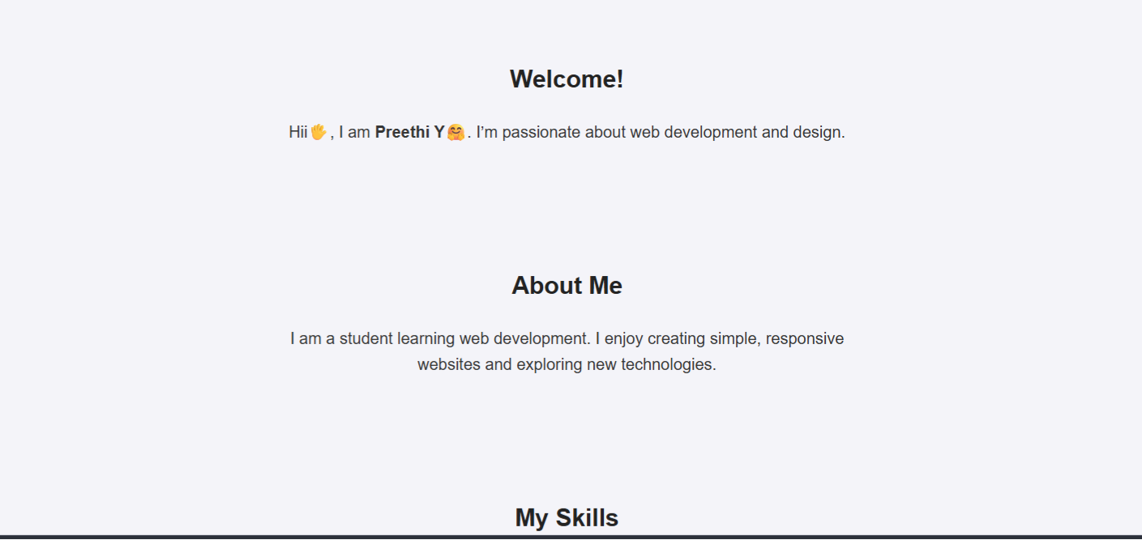

RESULTS AND SCREENSHOTS
3/21/2024 Annual Review
10

Slide 11
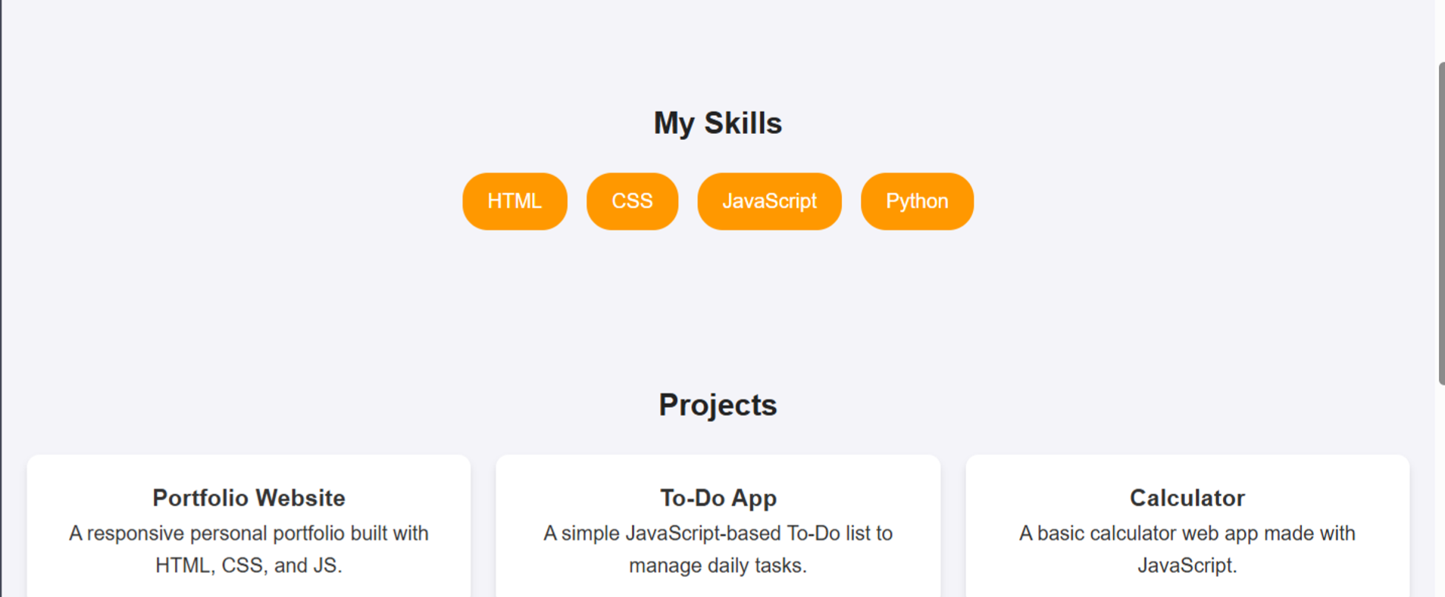

Slide 12
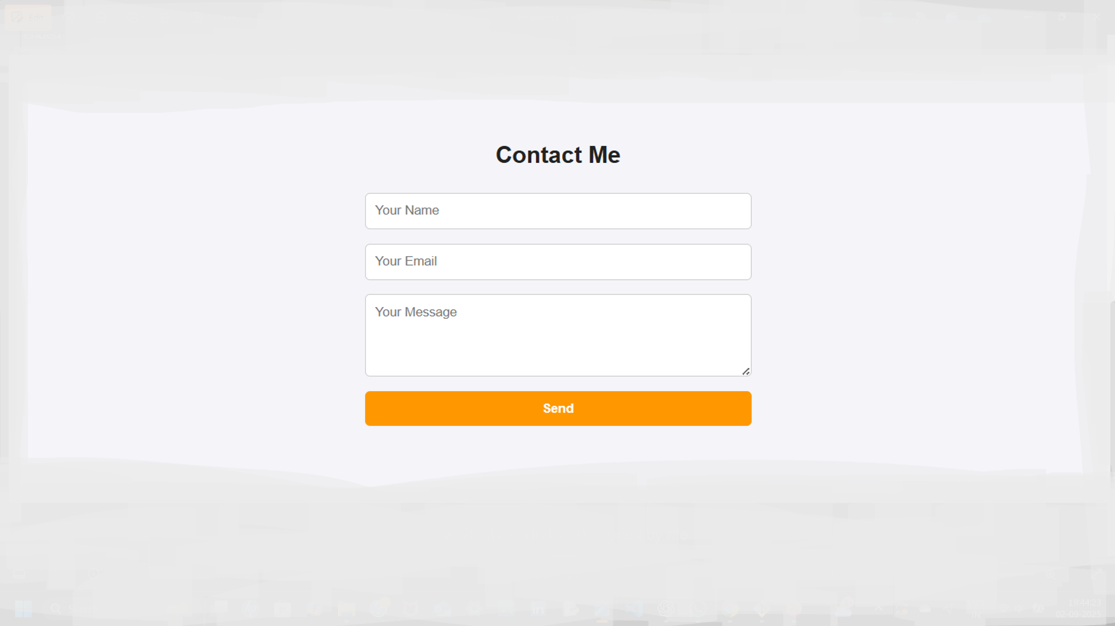

Slide 13
CONCLUSION 1. Digital portfolio enhances personal branding. 2. Makes recruitment & client acquisition easier. 3. Scalable and customizable for future improvements. 4. Demonstrates web development skills effectively.
13

